Slide 1
Chapter 5 Loops
Liang, Introduction to Java Programming, Tenth Edition, (c) 2015 Pearson Education, Inc. All rights reserved.

Slide 2
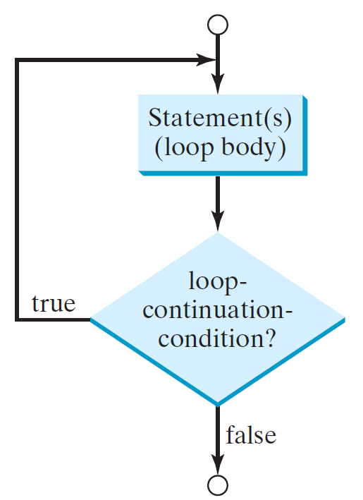
do-while Loop
do {
// Loop body;
Statement(s);
} while (loop-continuation-condition);

Slide 3
RepeatAdditionQuiz.java
Page 162 Listing 5.1

Slide 4
RepeatAdditionQuiz2.java
With a do-while loop

Slide 5
Caution, cont.
Similarly, the following loop is also wrong:
int i=0;
while (i < 10);
{
System.out.println("i is " + i);
i++;
}
In the case of the do loop, the following semicolon is needed to end the loop.
int i=0;
do {
System.out.println("i is " + i);
i++;
} while (i<10);
Logic Error
Correct

Slide 6
Formatting Output
Use the printf statement.
  System.out.printf(format, items);
Where format is a string that may consist of substrings and format specifiers. A format specifier specifies how an item should be displayed. An item may be a numeric value, character, boolean value, or a string. Each specifier begins with a percent sign.

Slide 7

Frequently-Used Specifiers
Specifier Output Example
%b a boolean value true or false
%c a character 'a'
%d a decimal integer 200
%f a floating-point number 45.460000
%e a number in standard scientific notation 4.556000e+01
%s a string "Java is cool"

Slide 8
FormatDemo.java
The example gives a program that uses printf to display a table.
Page 149 Listing 4.6
FormatDemo
Run

Slide 9
Ending a Loop with a Sentinel Value
Often the number of times a loop is executed is not predetermined. You may use an input value to signify the end of the loop. Such a value is known as a sentinel value.
Write a program that reads and calculates the sum of an unspecified number of integers. The input 0 signifies the end of the input.
SentinelValue
Run

Slide 10
SentinelValue.java
Pages 168-9 Listing 5.5

